Slide 1
Wherever you study you will learn the same working-life skills
The University of Oulu teaches generic skills, i.e. general working life skills, in all programmes starting in the academic year 2026–2027

Slide 2
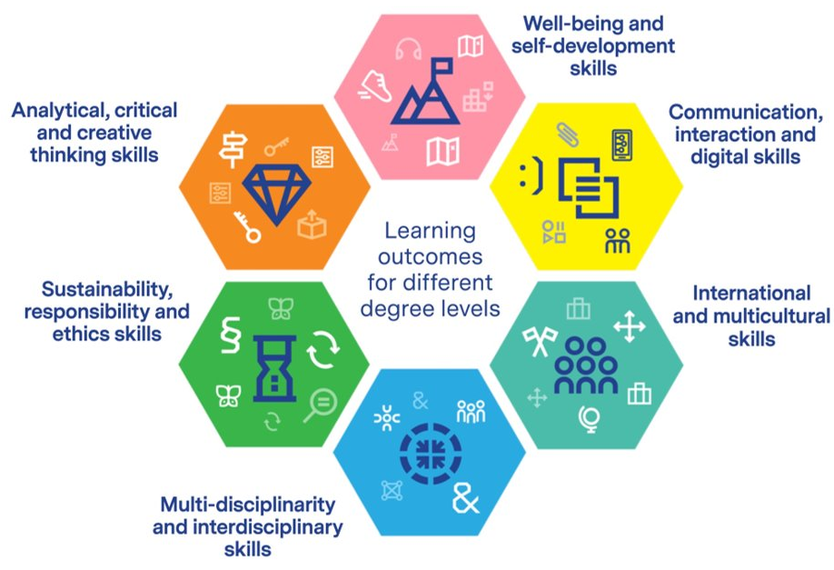
What are the common generic skills chosen by the University of Oulu?
The University of Oulu has defined generic skills i.e., general working life skills common to all degrees, including their learning outcomes, in a participatory process.
You will learn these common generic skills in all bachelor’s and master’s programmes starting from the academic year 2026–2027 and in doctoral degrees from academic years 2027–2030.
Generic skills are developed as part of the subject-specific compulsory studies of the degree programmes.
Discover the common generic skills of the University of Oulu and the degree-level learning outcomes.

Slide 3
What are generic skills?
Generic skills refer to skills common to all fields that are needed during studies and working life. These skills are needed alongside field-specific competence.
Generic skills include interaction skills, communication skills, critical thinking skills, collaboration skills, creativity, ethical skills, problem-solving skills or self-regulation skills.
Many synonyms are used for generic skills, such as working life skills, general skills, common competencies, 21st century skills, soft skills, transferable skills or academic specialist skills.

Slide 4
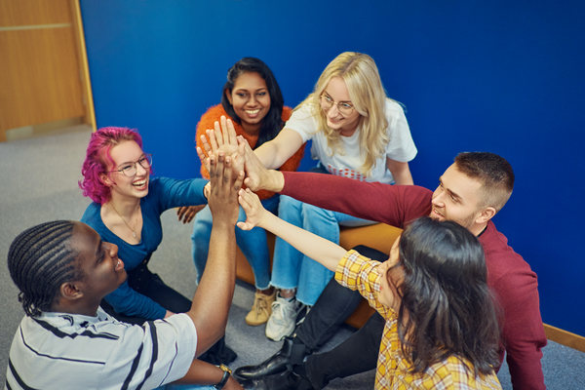
Why are generic skills important in studies and working life?
Generic skills strengthen learning and success in working life.
Generic skills support your learning of field-specific knowledge and skills and thereby enhance your academic success. They help you develop as a thinker, a learner and an expert.
Working life needs experts who, in addition to strong field-specific knowledge, have generic skills.
Strong generic skills increase your likelihood of succeeding in working life after graduation and being satisfied with your degree.
These shared skills are not an extra add-on, but an essential part of your degree – and you will develop them throughout your studies.
By developing these skills during your studies, you strengthen your ability to face complex future challenges and improve your employability.

Slide 5



You will learn these generic skills in degree programmes at the University of Oulu (1/2)
Generic skill | A person with a bachelor's degree… | A person with a master's degree… | A person with a doctoral degree…
Analytical, critical and creative thinking skills | identify the key skills of analytical, critical and creative thinking and be able to observe them in their own activities identify and be able to describe the importance of analytical, critical and creative thinking in scientific, professional and ethical activities is able to critically evaluate knowledge in their own field and apply it to solve complex and unpredictable problems. | is able to apply analytical and critical thinking skills in a manner appropriate to their discipline, considering the interfaces between fields and new knowledge is able to apply creative thinking and problem solving in their work to develop new knowledge and new procedures is able to analyse arguments and argue appropriately. | is able to combine analytical, critical and creative thinking skills to solve complex problems in research or innovation activities is able to develop and apply innovative approaches to problem solving and to build and evaluate well-founded arguments from different perspectives is able to utilize analytical, critical and creative thinking across disciplines in producing new knowledge and solving problems.
Well-being and self- development skills | identifies key elements related to their own well-being and self-management identifies stressors related to expert work and utilizes self-compassion to support well-being is able to describe their own expertise, develop their own professional identity, promote group learning and development, and recognize the need for lifelong learning. | knows how to promote their well-being, develop their self-management skills and build their professional identity, and maintain their own competence in a goal-oriented manner knows how to act constructively in situations of uncertainty and discomfort, develop self-compassionate ways of acting, and promote community and interaction to support well-being. | is able to use and actively develop self-management skills within a scientific framework is able to set professional goals, plan their career and develop and maintain one's own competence in research and development activities.
International and multicultural skills | recognizes the diversity of cultures and the problematic nature of stereotypes related to different language, nationality and ethnic groups, and recognizes stereotypical ways of thinking is able to work in multicultural teams and act openly in international and multinational situations with people from different cultural backgrounds. | is able to work in international cooperation and take the international operating environment into account in their activities is able to promote constructive cooperation with people from different backgrounds, develop their language skills and be able to challenge their own stereotypical thinking patterns. | is able to promote international cooperation and build and utilise global networks.

Slide 6



You will learn these generic skills in degree programmes at the University of Oulu (2/2)
Generic skill | A person with a bachelor's degree… | A person with a master's degree… | A person with a doctoral degree…
Sustainability, responsibility and ethical skills | identifies the dimensions of sustainability (social, ecological, economic, cultural) and evaluate their own actions in relation to them identifies the UN Sustainable Development Goals (SDGs) knows how to work equally and equitably with different people in accordance with professional ethics and good scientific practice, respecting different stakeholder groups, environments and values. | recognizes the dependencies between the dimensions of sustainability (social, ecological, economic, cultural) in their own field of study and is able to assess the impacts of their own field's activities on them is able to apply the UN Sustainable Development Goals in their own professional activities and identify ways to participate in social debate and decision-making in their own field is able to solve ethical questions in their field with sound reasoning and justify their actions ethically, taking into account different backgrounds, positions of power, values, and environments. | is able to place research activities in a broader context in order to understand complex issues and to evaluate their own research taking into account the perspectives of sustainability and global justice is able to promote the UN's Sustainable Development Goals in their own field of research and development is able to act responsibly and proactively in accordance with professional ethics and good scientific practice, and to consider the impacts of their actions on stakeholders and the environment.
Multidisciplinarity and interdisciplinary skills | is able to compare the differences and similarities between their own field of study and related disciplines is able to be open to the perspectives of representatives of other fields and to identify possible interdisciplinary perspectives that could promote the development and cooperation of their own field is able to work in multidisciplinary and multiprofessional teams and appreciate expertise across different fields. | is able to apply the methods of their own discipline and recognise the strengths and limitations of methods in other disciplines is able to seek and combine expertise from different fields to find innovative solutions to global challenges as part of a working group is able to promote multidisciplinary cooperation and lead multidisciplinary and multiprofessional teams. | is able to integrate methods from their own discipline and other fields into their research and evaluate their compatibility and impact in research and practical applications is able to develop multidisciplinary and multi-professional solutions to global challenges, combining expertise from different fields in an innovative way is able to lead and develop multiprofessional and multidisciplinary cooperation, acting as a trendsetter and influencer in different expert environments.
Communication, interaction and digital skills | can communicate clearly orally and in writing to both experts in their field and to other audiences, including in a foreign language is able to communicate clearly in a group, actively listen to others, give constructive feedback and resolve conflicts constructively is able to develop their communication, interaction and multi-literacy skills is able to use digital and AI applications relevant to their field in their studies appropriately, safely, and responsibly. can communicate and discuss in their mother tongue and second domestic language (this learning outcome only applies to degrees in Finnish). | is able to communicate as an expert in a way suitable for the target audience, also in a foreign language, and to build professional networks is able to evaluate the activities of individuals and groups, such as the achievement of goals, group dynamics, communication and work atmosphere, is able to provide constructive feedback, guidance and development suggestions to others and lead a team is able to utilise and critically evaluate digital solutions and AI technologies in their own area of expertise appropriately, safely and responsibly, and to identify their impacts on research, working life and society. | is able to communicate effectively and discuss dialogically with the scientific community and other audiences about their own research and discipline is able to present their own research and its results and impacts in the scientific community and beyond is able to apply methods, practices, and solutions based on digital technology and AI appropriately, safely, and responsibly in research, development work, and in demanding expert tasks in their own discipline.

Slide 7
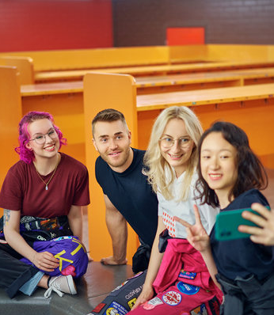
Learning generic skills
From your perspective, learning and assessing generic skills means that these skills are integrated into your course assignments and content.
You will practice generic skills as part of your field-specific studies through various tasks, such as group work, project and laboratory work, seminars and internships.
Your teachers make these skills visible in courses and explain which generic skills you will develop in each course.
You are not expected to master everything at once – you will gradually develop your generic skills through different learning tasks, and they will grow throughout your studies.
Your generic skills are often assessed qualitatively: you receive feedback from teachers and working-life representatives, evaluate your own learning, and give peer feedback. The goal is learning and development, rather than just a grade.
You will take time to reflect on your own actions, thinking and experiences – and you will also learn from other students.
You are an active participant in your own learning: you reflect on the kind of expert you want to become, what skills you already have, and what you still want to learn.

Slide 8
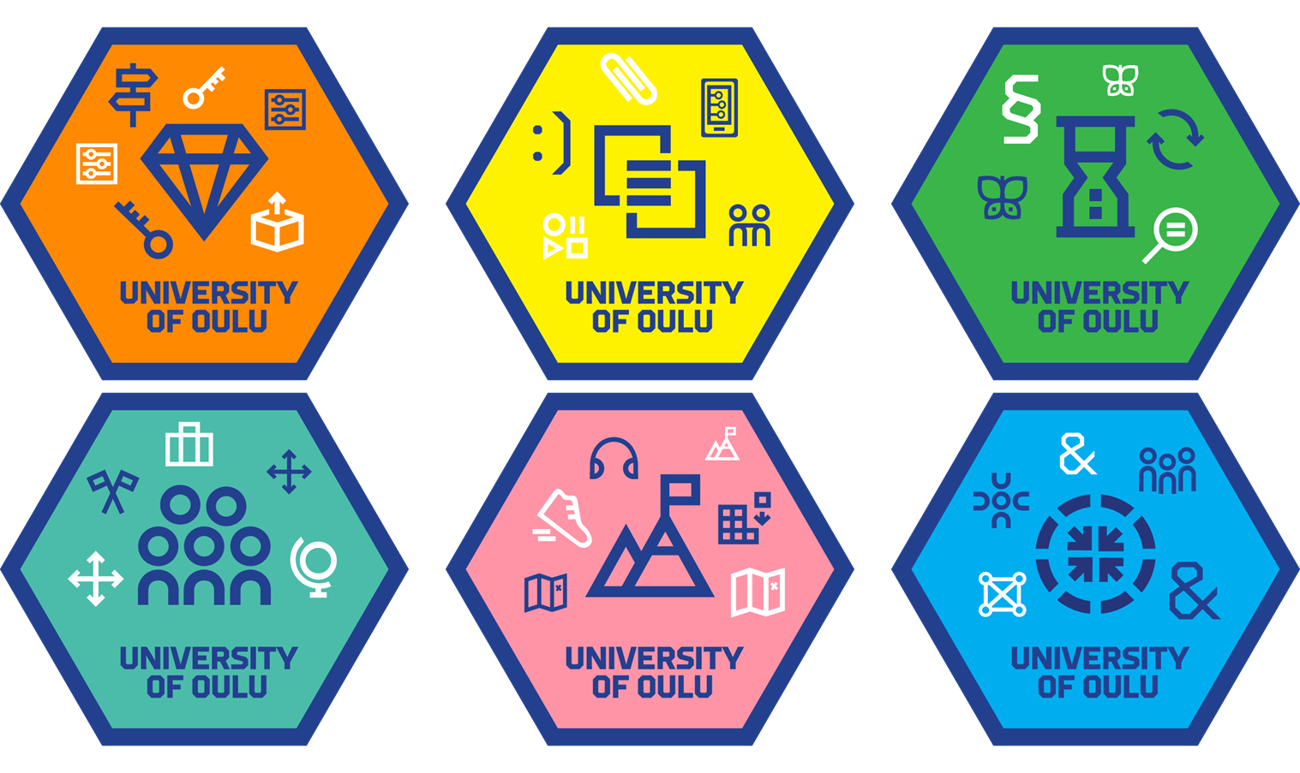
After graduation, you will receive digital badges for your generic skills
All students who begin their studies at the University of Oulu in autumn 2026 will receive digital badges for generic skills via email upon graduation.
The badges describe the degree-level generic skills learning outcomes.
You can use the badges, for example, in your CV and job applications.

Slide 9


